Slide 1
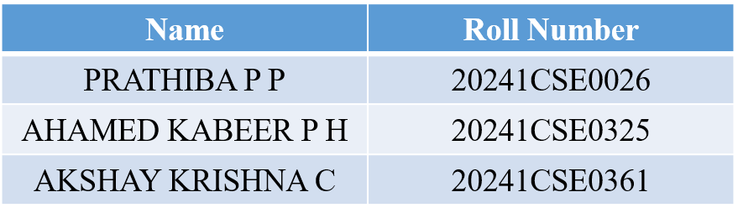
PROJECT X – 1.0 Phase –II Review Presentation (20th Nov 2025) SLEEP PATTERN TRACKER
By
TEAM NO. 113

Slide 2
PROJECT BRIEF SUMMARY
PROJECT’S PURPOSE – A SLEEP PATTERN TRACKER FOR STUDENTS
10%​
Mental Issues
WHY THIS PROJECT?
20%​
Irregular Sleep
Schedule
Lead to:
Reduced concentration & memory
Lower academic performance
Stress, fatigue, and mood problems
40%
Academic stress
30%​
Late Night Phone
Use

Slide 3
MAJOR UPDATES
Integrated sensors for sound ,motion and heartrate detection
Optimal code performance for faster data processing
Detailed Research on (MAX30102, MPU6050, MAX4466)
Faced real-world examples and learnt new concepts

Slide 4
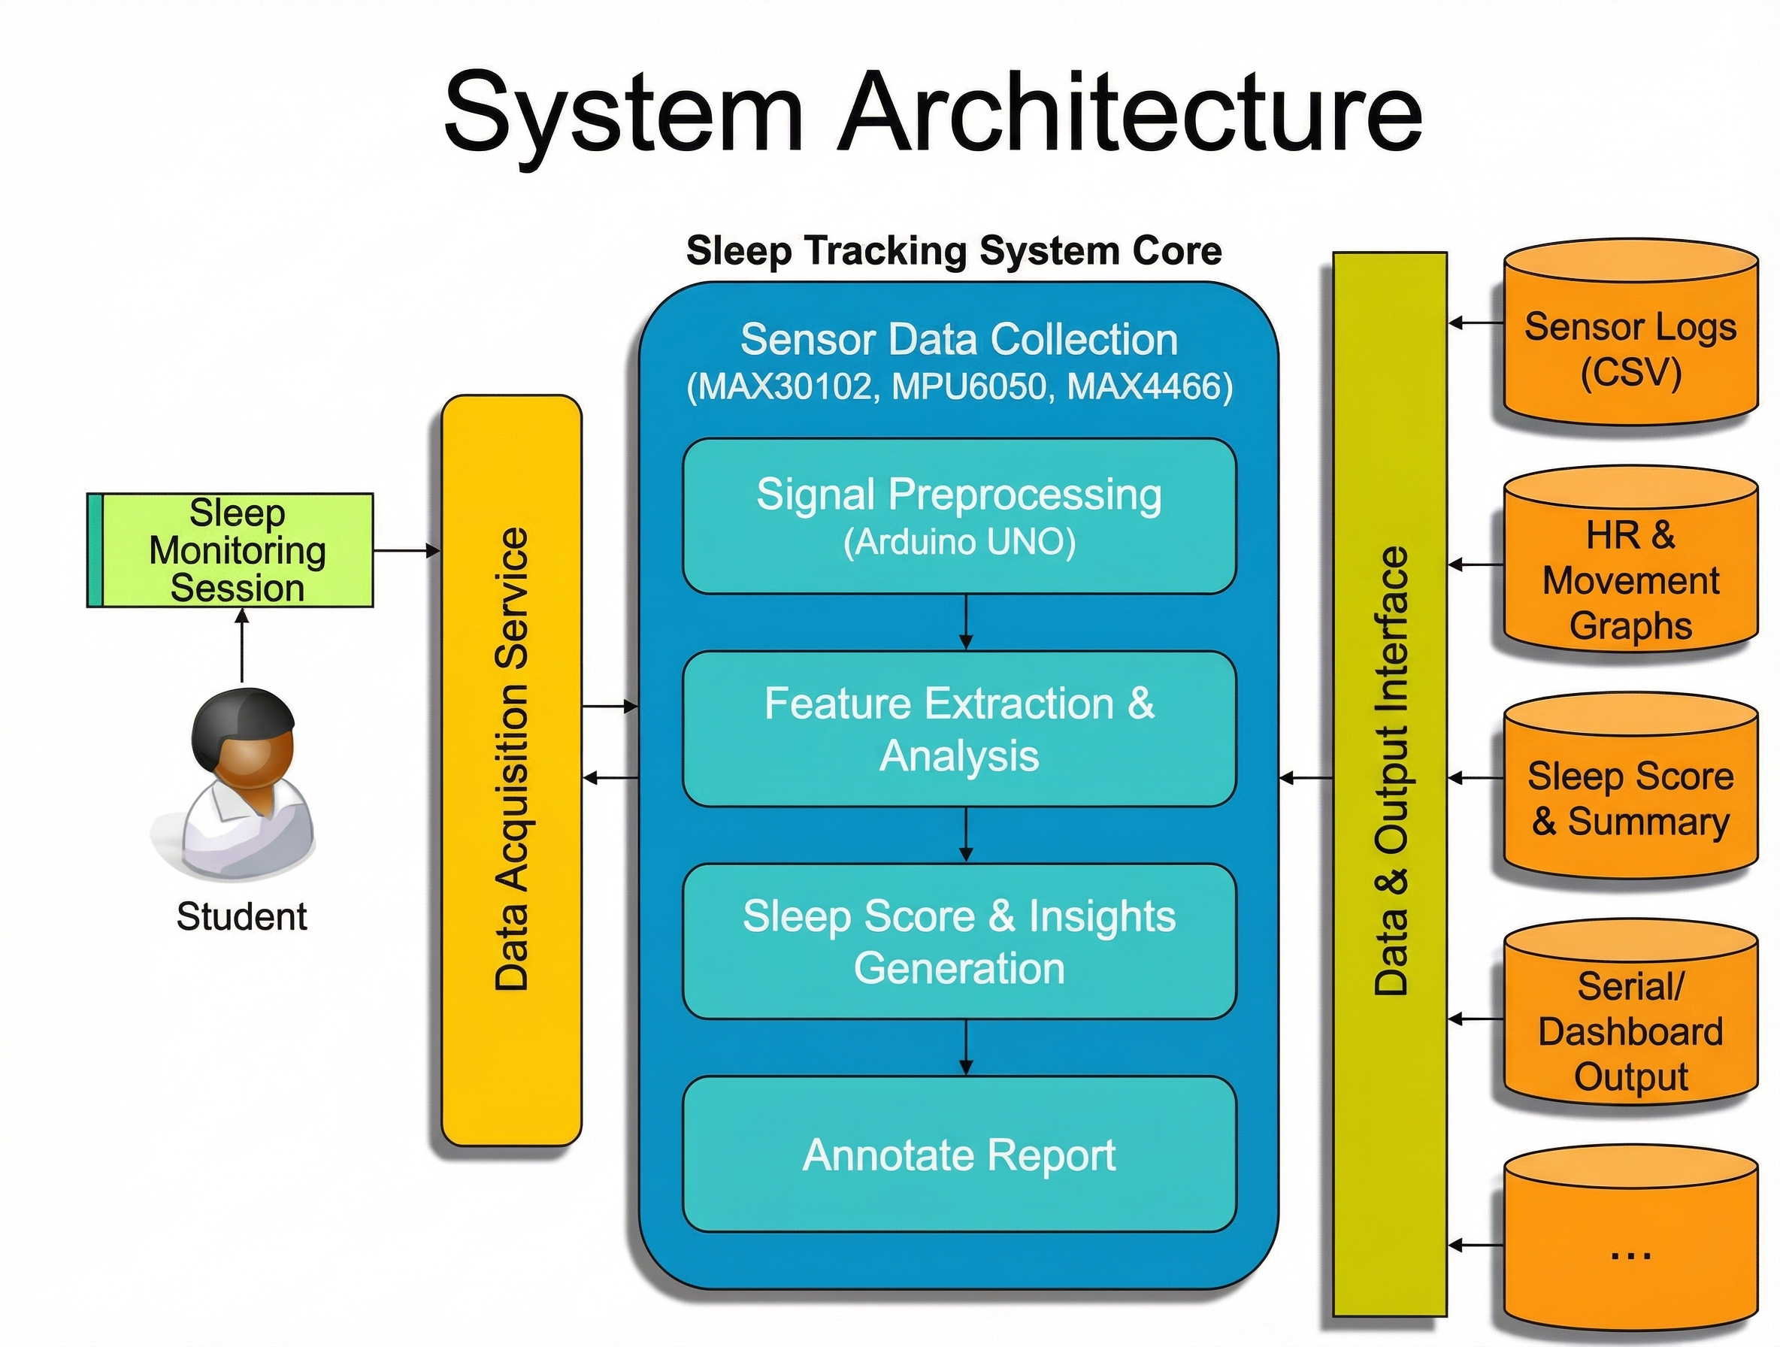
System Architecture / Workflow

Slide 5
TECHNICAL IMPLEMENTATION
Sensor Libraries (Arduino APIs)​ Used built-in libraries like MAX30102 APIs and MPU6050 APIs to read heart rate, motion, and snoring signals
Data Processing APIs (Python Libraries)​ Used simple APIs like NumPy and Matplotlib for filtering and visualizing sleep data.
Libraries used:
Wire.h, Adafruit_MPU6050.h
MAX30105.h heartrate/SpO2
Adafruit_Sensor.h
Python/Colab → analysis & plotting
Tools used: Arduino IDE, Python, Matplotlib

Slide 6
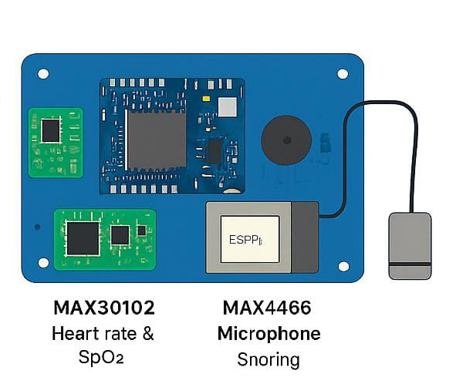
PROTOTYPE / WORKING MODEL DEMONSTRATION
Heart-Rate Monitoring (MAX30102)
Detects breathing patterns
Identifies light sleep, deep sleep, or wake events
Detects heart-rate variability (HRV)
Measures snoring intensity
Captures sudden disturbances (cough, noise)

Slide 7
Key Achievements / Results (Very Short)
Successfully built a multi-sensor sleep tracking prototype using MAX30102, MPU6050, and MAX4466.
Achieved accurate heart-rate, movement, and sound detection during sleep.
How the Solution Benefits Users / Society
Helps users understand their sleep quality without expensive medical equipment.
Detects patterns related to stress, poor sleep habits, or breathing issues.
Encourages better sleep routines with data-driven insights.
Comparison / Feedback
Compared to app-based trackers, this hardware model gives more accurate physiological data (real heart rate & motion).
RESULT AND IMPACTS

Slide 8
CHALLENGES FACED I2C sensor not detected(initial wiring issues) Sensors also deducting environmental noise including the sleep data
PLAN TO OVERCOME
Verified correct microphone type (analog MAX4466)
Switched to an analog mic, which is Uno-compatible
Changed the microcontroller from ESP32 toARDUINO UNO
KEY LEARNINGS &IMPROVEMENTS Better Understanding of Hardware Integration
Improved Debugging and Problem-Solving Skills
Clearer Vision for Next Phase (ML + App)

Slide 9
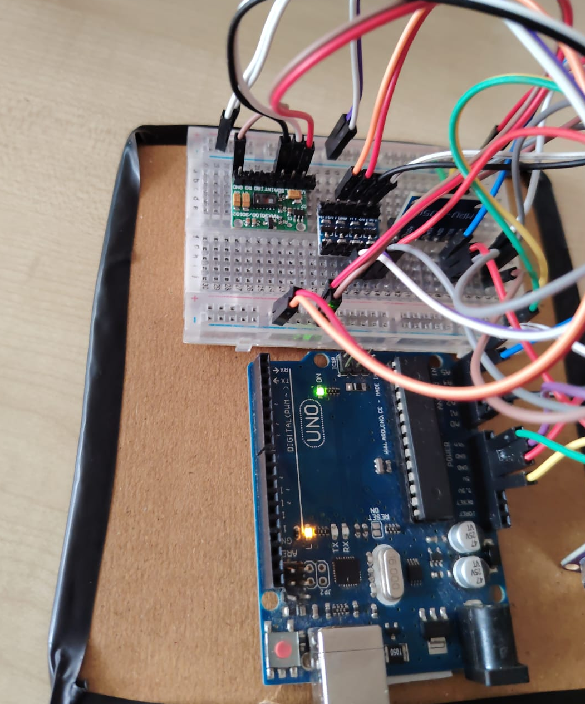
RESULT:ACCURACY=60-65%

Slide 10
CONCLUSION
Key Outcomes & Learnings
Built a working multi-sensor sleep tracker.
Learned hardware integration, debugging, and basic signal processing.
Usefulness / Impact
Helps users understand sleep quality, detect restlessness, and monitor health.
Low-cost solution for early sleep issue detection.
Future Enhancements
Add ML for sleep stage detection.
Build a mobile app and wearable version.
Support cloud-based long-term tracking.

Slide 11
LIVE DEMO

Slide 12
Thank you !!

Slide 13
Any queries ?

